Slide 1
US Decision Science
Estimating Lagged Effect of Promotional Interventions
Jan 2007

Slide 2
Objectives
Review approaches used in PM&T group for estimating lagged effect of promotional interventions
Present recommendations for standardizing the estimation of the lagged effects of advertising across brands

Slide 3
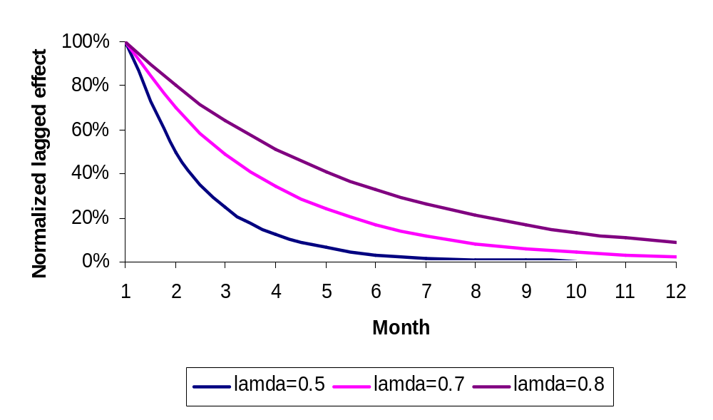
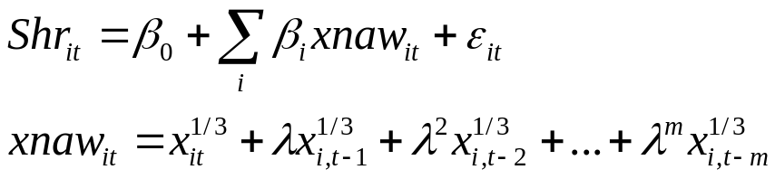
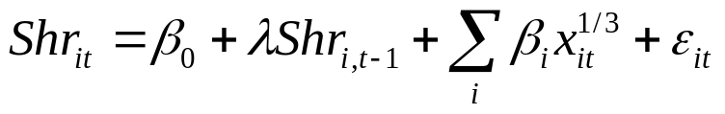
Conventional Lag Structure (Geometric Decay)
Estimation methods-NAW, Koyck
Assumes that the lagged effect is same for all channels
Assumes a geometric decay
Cannot handle the case of peak effect of promotion occurring in a period after the promotional period
NAW Method:
Involves constructing NAW (stock) variables
Involves grid search for the estimate of lamda
Assumes no effect after a specific period (m in this example)
Koyck Method:
Automatic estimation of lamda

Slide 4
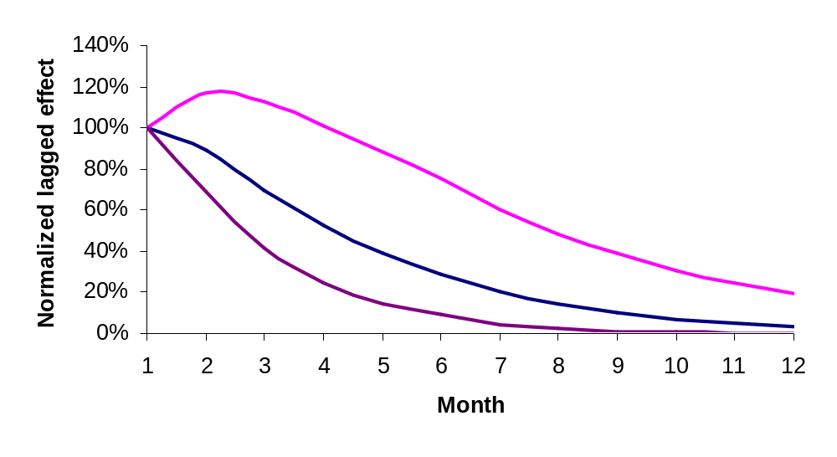

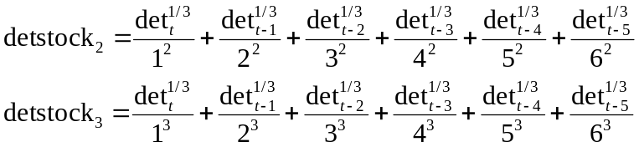
PIL (Polynomial Inverse Distributed Lag Structure)
Estimation methods-PIL
Can accommodate different lags for different channels
Does not assume a geometric decay
Can handle the case of peak effect of promotion occurring in a period after the promotional period
Regression model with lagged predictors
(Only details shown for illustration)
Lagged effects constrained to lie on a polynomial
Translates to working with two stock variables for details and estimating a regression on two parameters (α1 and α2)

Slide 5
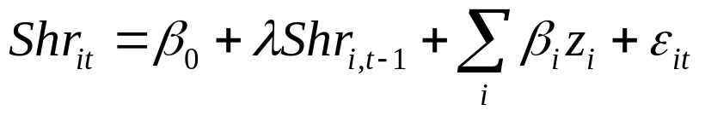



Estimation Method
Model is estimated in stages to address multicollinearity
Stage 0:
  Construct orthogonal auxiliary variables {z1, z2,…,zk} that approximate the original variables {x1,x2,…,xk}
    Find the (latent) Z variables such that correlation with (manifest) X variables is maximized (SVD Method)
Stage 1:
  Perform a regression using Z-variables
Stage 2:
  Assume the relative impact of X variables to be the same as Z variables
  Create a new variable
  Perform a regression on the new variable
The coefficient for variable x_i is

Slide 6
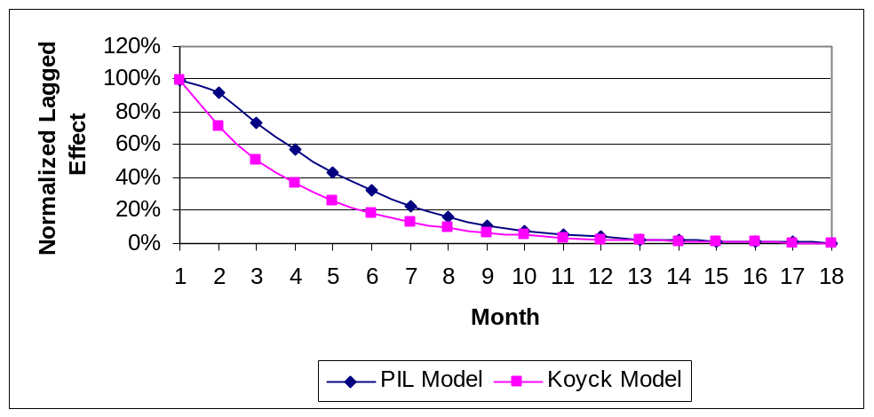
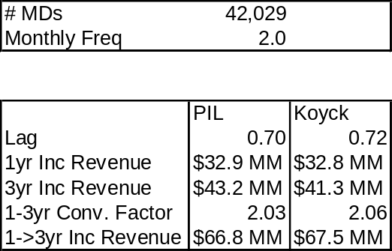
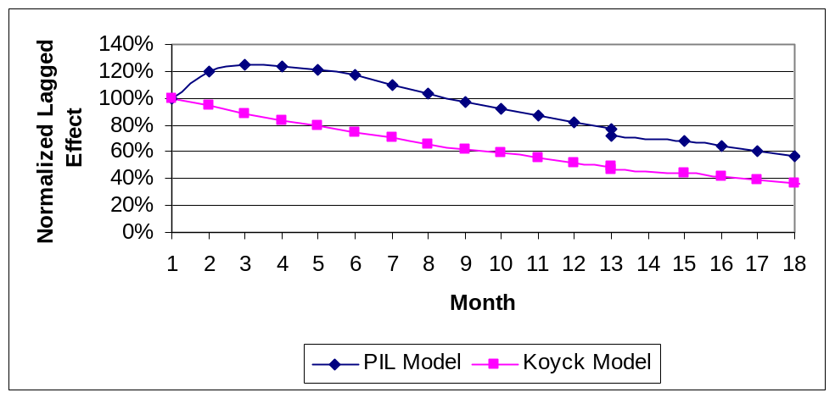
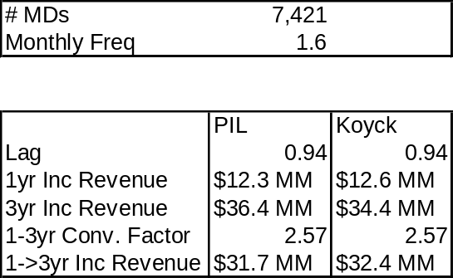
Comparison of decay from Koyck and PIL models – Example: Cialis and Evista Details
Cialis PCPs ED decile 4-10
Implied yearly CO = 25%
Evista OBGs Bone decile 3-10
Implied yearly CO = 98%

Slide 7
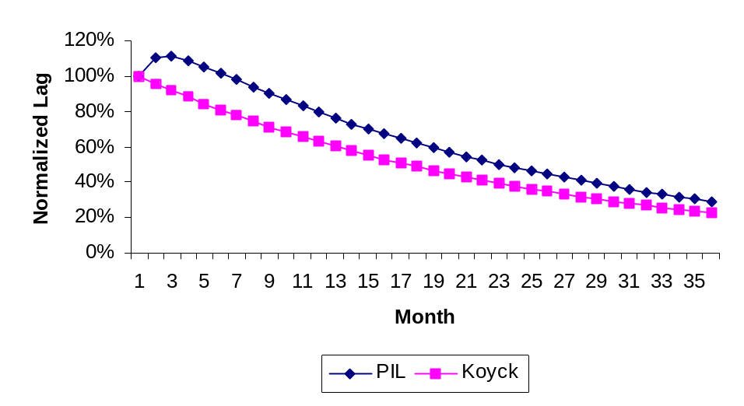

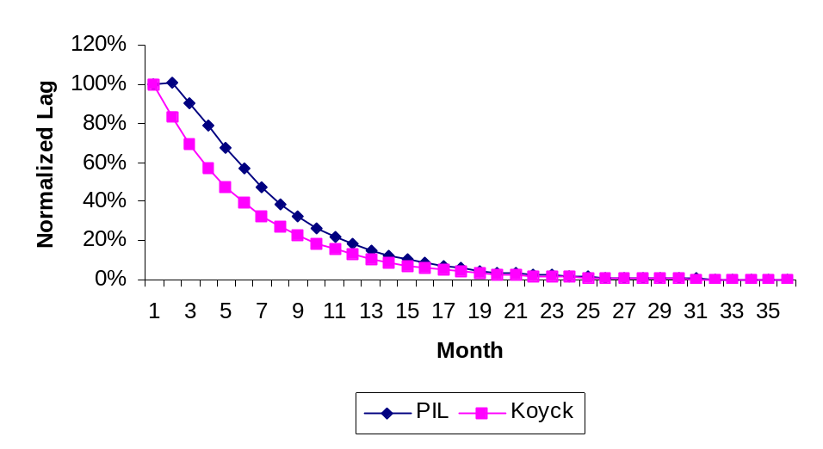

Comparison of decay from Koyck and PIL models – Example: Cymbalta MDD and DPNP
Cymbalta MDD Psy 7-10
λ=0.959
3 Yr Inc Revenue ($MM)
Implied yearly CO = 108%
λ=0.959
Cymbalta DPNP Neu/Pain 7-10
3 Yr Inc Revenue ($MM)
λ=0.826
λ=0.83
Implied yearly CO = 44%

Slide 8
Observations
Observed 5%-15% difference in incremental revenue estimates between the PIL and Koyck models based on tested examples
PIL model offers more flexibility by:
  a) allowing the effect of advertising to reach the peak in periods after the promotional period
  b) allowing individual decay patterns for various promotion channels
3 year incremental revenue figure may vary considerably depending on the method of extending 1 yr revenue to 3 yr revenue:
  Past calculations for certain brands assume the yearly carryover to be the same value as the monthly lag.
      1->3 year conversion = model’s 12 month decay x (1+(CO/(1+.11)+(CO/(1+.11)^2),
      where CO is assume to be the same as monthly lag lambda and .11 refers to the 11% hurdle rate
  However, the implied carryover based on actual decay 36 month decay pattern from the model is typically lower than monthly lag if monthly lag is less than 0.9 and greater if monthly lag is greater than 0.9

Slide 9
Other considerations
• Monthly versus quarterly model
NRx versus SOM model
Using same decay across the segments versus Using different decay by segment

Slide 10
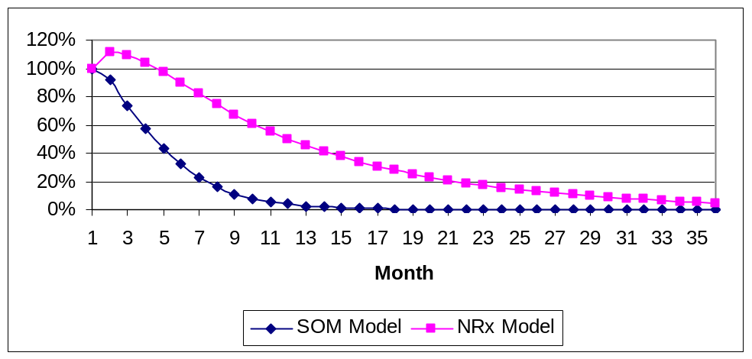
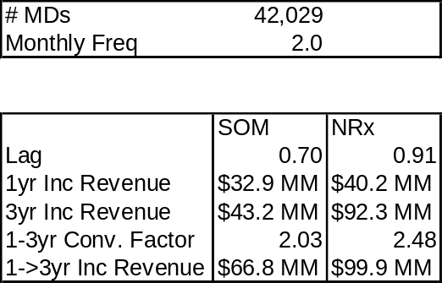
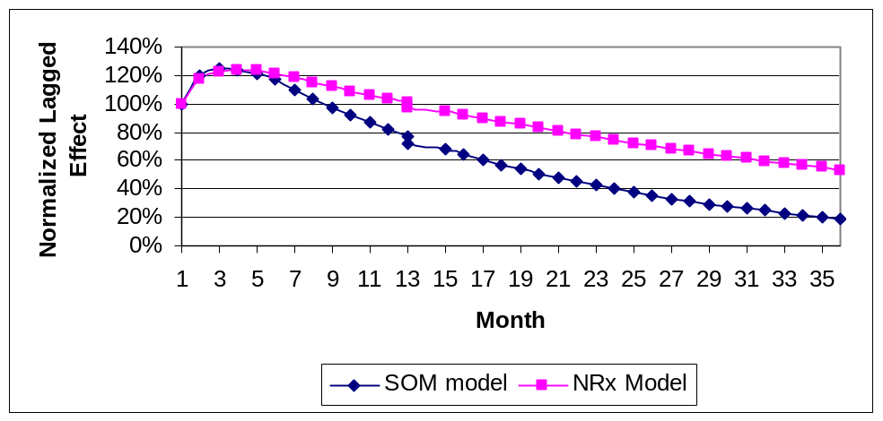
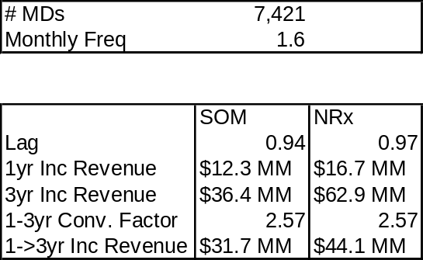
SOM vs. NRx PIL model decay comparison
– Example: Cialis and Evista Details
Cialis PCPs ED decile 4-10
Evista OBGs Bone decile 3-10

Slide 11
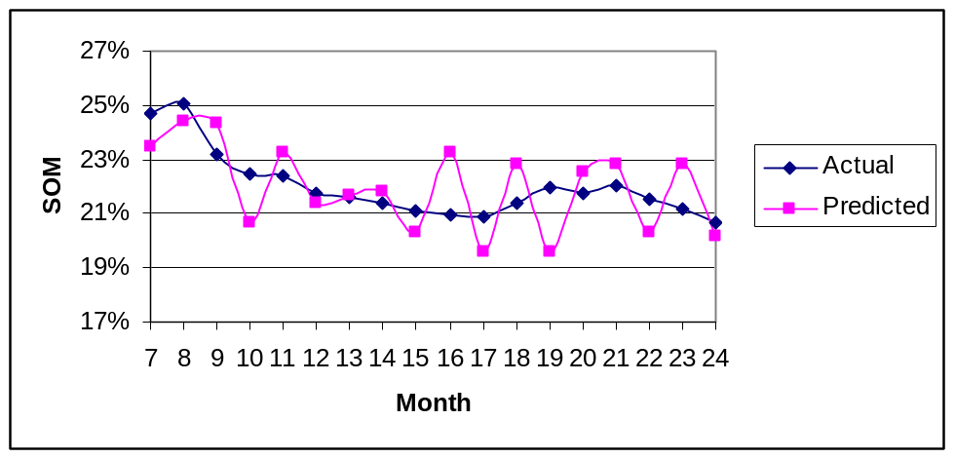
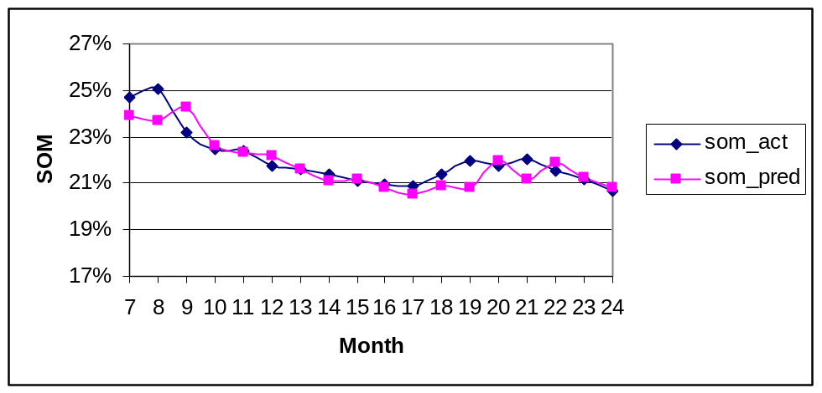
SOM vs. NRx PIL model goodness of fit
– Example: Evista Details
NRx Model
MSE = 855
SOM Model
MSE = 400

Slide 12
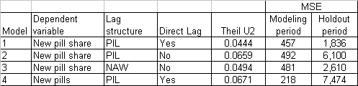
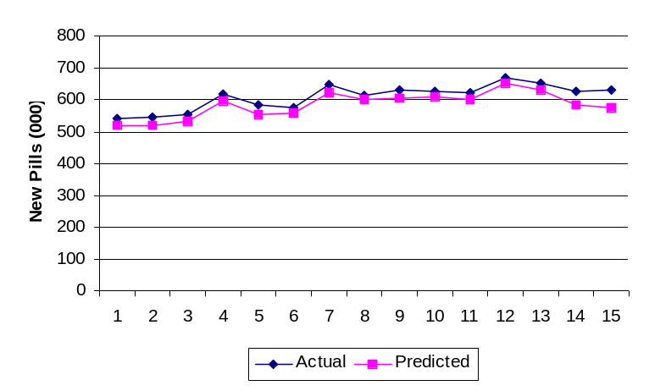
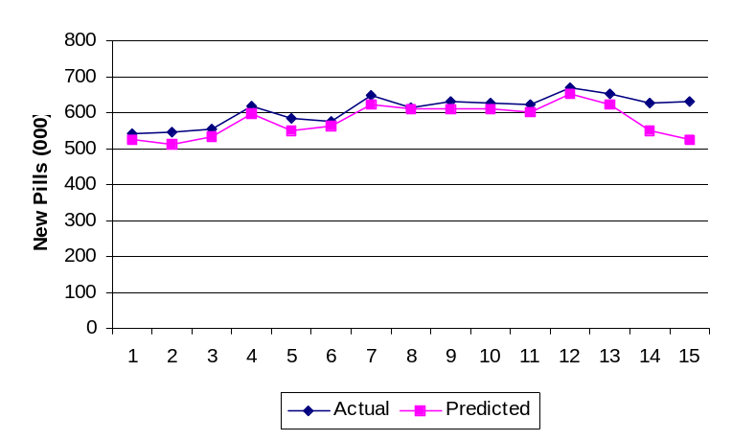
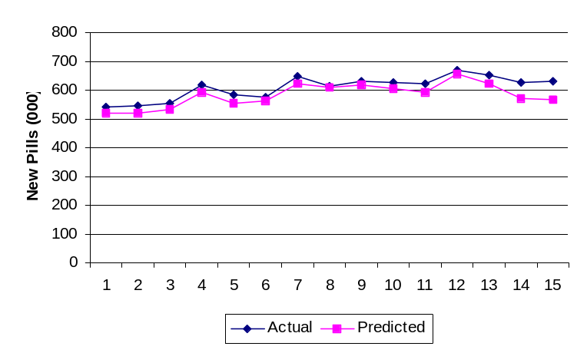
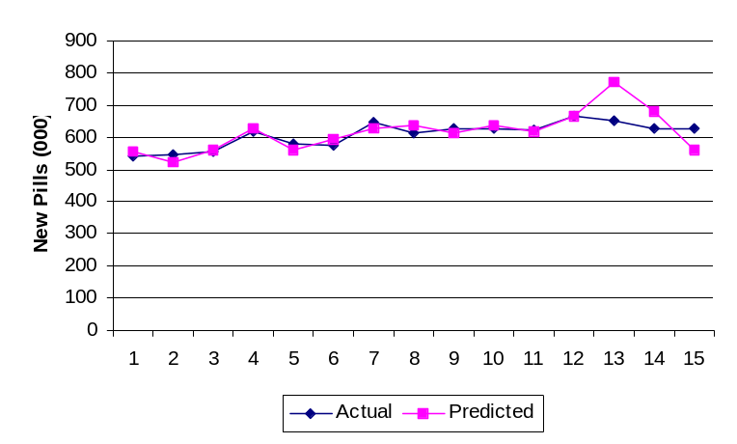
SOM vs. NRx PIL model validation
– Example: Cialis DTC Model
Although this model is slightly better than other models on the basis of prediction, it also has the advantage of being a better decision-making tool
1
2
Sep04-Aug05
Modeling period
Sep05-Nov05
Validation period
3
4

Slide 13
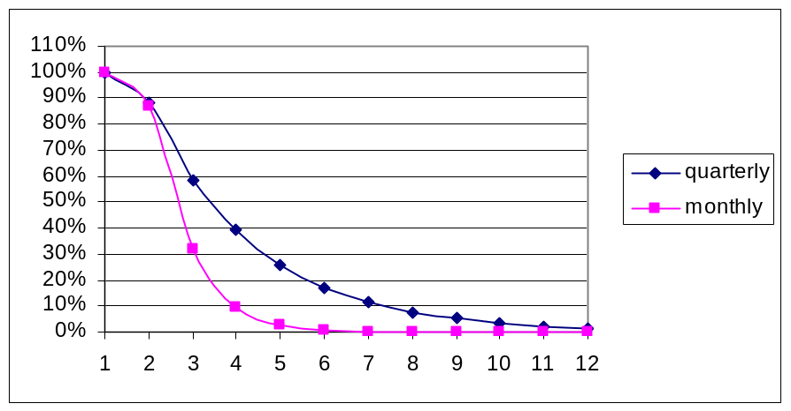
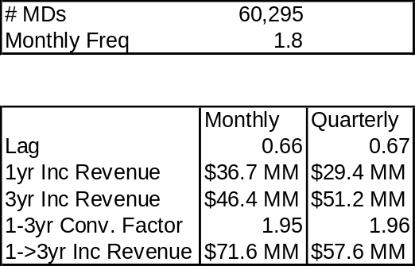
Monthly vs. Quarterly model decay comparison
– Example: Cialis Details
Cialis PCPs ED decile 3-10
Quarterly model has slower decay than the monthly model.
The 3-year incremental revenue is similar when calculated directly from the model’s 36 month decay,
However, in the past for certain brands, we estimated 3 yr inc revenue by multiplying model 1 yr revenue with (1+CO/1.11+(CO/1.11)^2). This leads to larger differences between monthly and quarterly model
Following article suggests using the data interval that corresponds to the most frequent intervention as the modeling period (in our case that would be monthly since details happen every month)
  Tellis and Franses, Optimal data interval for econometric models of advertizing carryover (available in web)
They also provide the following intuition for quarterly models having a slower decay compared to monthly models
  Aggregate data assigns all exposures in the data interval to a single arbitrary point and attributes the observed decay as the avg effect of all exposures within the interval

Slide 14
Recommendation
It is important to have a consistent methodology so that it is easy to compare results across brands
Suggested methodology for this round
  Monthly model
  Share as dependent variable
  PIL to model lag
  3 yr revenue directly from model decay
  Make product specific adjustments more transparent
    Adjustments to incorporate lifecycle
    Adjustments to make inc revenue estimates reasonable when compared to forecasts
What if results are very different from BC III/Call plan curves of last round of analysis?

